Slide 1
TITLE:AI-DRIVEN EXPLORATION AND PREDICTION OF COMPANY REGISTRATION TRENDS WITH REGISTRAR OF COMPANIES

Slide 2
INTRODUCTION
In the age of data-driven decision-making, the innovation of applying Artificial Intelligence (AI) to the exploration and prediction of company registration trends with the Registrar of Companies emerges as a pivotal force in transforming how businesses, investors, and government agencies navigate the dynamic corporate landscape.
Harnessing the capabilities of AI, such as Natural Language Processing, predictive modeling, and sentiment analysis, this project empowers stakeholders to unveil hidden insights, anticipate future trends, and adapt to regulatory changes with unparalleled precision.
This visionary endeavor promises to provide a competitive edge to businesses, enhance regulatory oversight, and foster a more informed and agile ecosystem for all participants in the corporate realm.

Slide 3
Natural Language Processing (NLP) for Document Analysis:
Use NLP techniques to analyze unstructured data from registration documents, such as business descriptions and company names. This can help identify emerging trends in industries and business activities.

Slide 4
Time Series Analysis:
Implement time series analysis to track registration trends over time. This can reveal seasonal or cyclical patterns, helping businesses plan their operations accordingly.

Slide 5
Geospatial Analysis:
Incorporate geospatial data to identify regional variations in registration trends. This can be useful for businesses looking to expand into new markets.

Slide 6
Sentiment Analysis:
Apply sentiment analysis to news articles and public sentiment related to business registrations. This can provide insights into how public perception and media coverage influence registration trends.

Slide 7
Predictive Modeling:
Develop predictive models that forecast future registration trends. Machine learning algorithms can analyze historical data to make these predictions, helping businesses and policymakers prepare for changes.

Slide 8
Competitor Analysis:
Utilize AI to identify and track the registration patterns of competitors. This can provide businesses with insights into their competitive landscape.

Slide 9
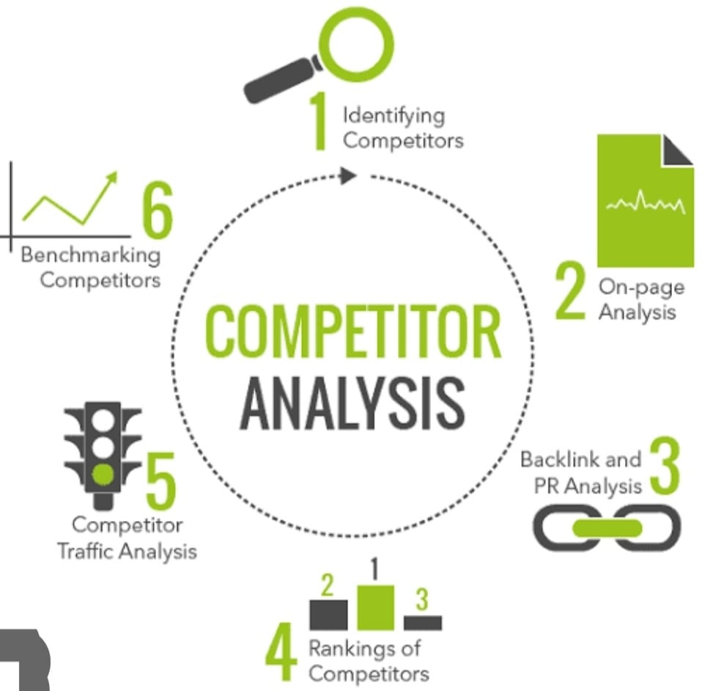
Competitor Analysis

Slide 10
Fraud Detection:
Integrate AI-driven fraud detection systems to identify potentially fraudulent company registrations. This can help reduce financial and reputational risks for stakeholders.

Slide 11

FRAUD DETECTION

Slide 12
Data Visualization:
Create user-friendly dashboards and data visualization tools that allow users to explore registration trends, view predictions, and extract actionable insights.

Slide 13
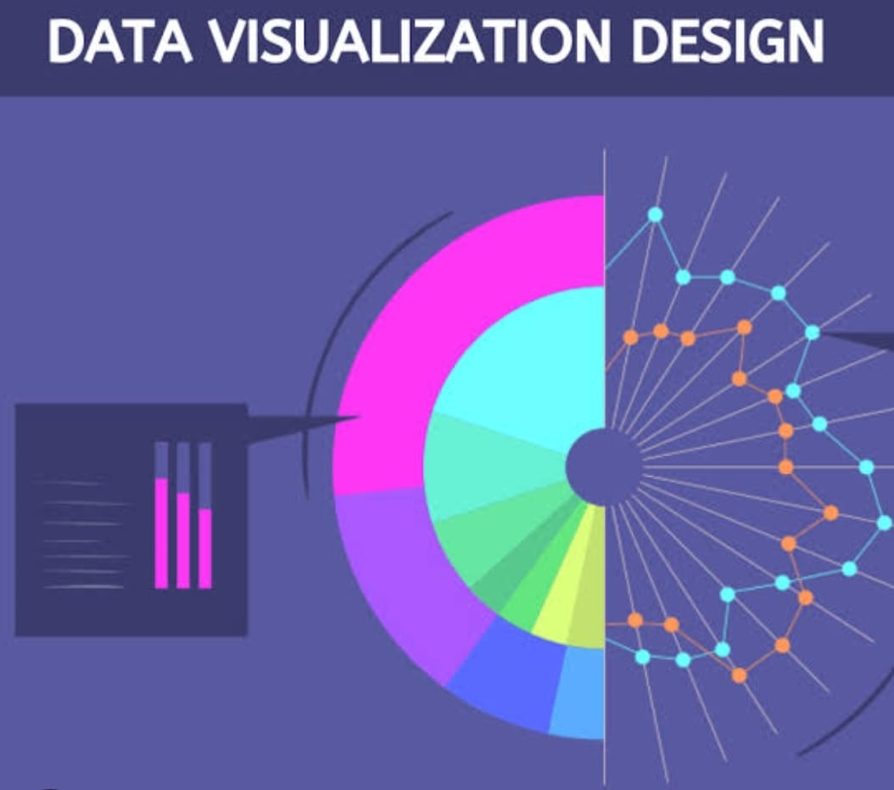
DATA VISUALIZATION

Slide 14
Regulatory Compliance Monitoring:
Implement a system to monitor changes in company registration laws and regulations. This can help businesses stay compliant and adapt to new requirements.

Slide 15
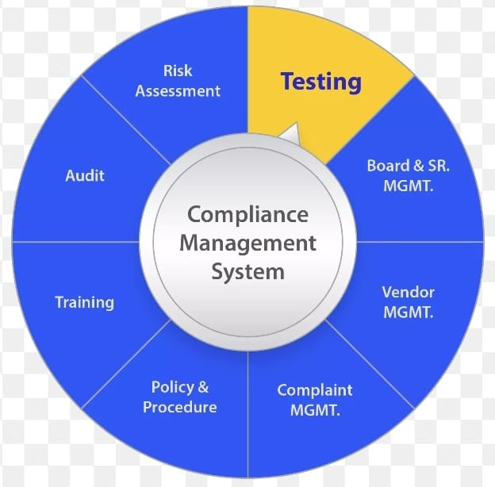
REGULATORY COMPLIANCE MONITORING

Slide 16
Industry-Specific Insights:
Customize the system to provide industry-specific insights. For example, it could offer unique predictions and trends for tech startups, manufacturing companies, or retail businesses.

Slide 17
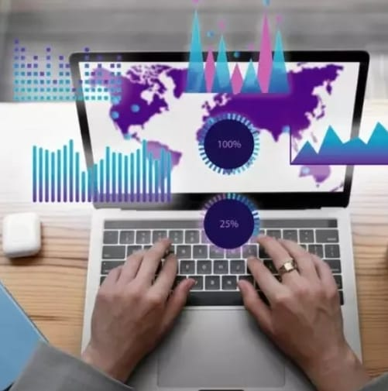
INDUSTRY SPECIFIC INSIGHTS

Slide 18
API Integration:
Provide APIs that allow businesses, investors, and other stakeholders to access the system's data and predictions, enabling them to integrate this information into their own applications.

Slide 19
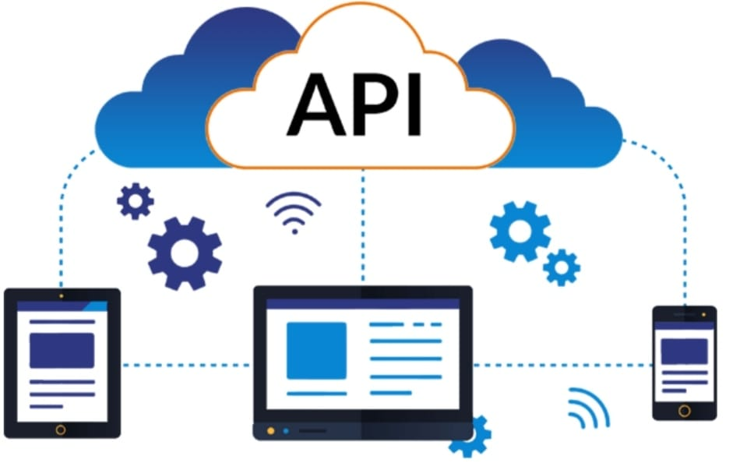
API INTEGRATION

Slide 20
Collaboration with Government Agencies:
Collaborate with government agencies to enhance data accuracy and access to up-to-date information. This partnership can ensure the system remains in line with regulatory changes.

Slide 21
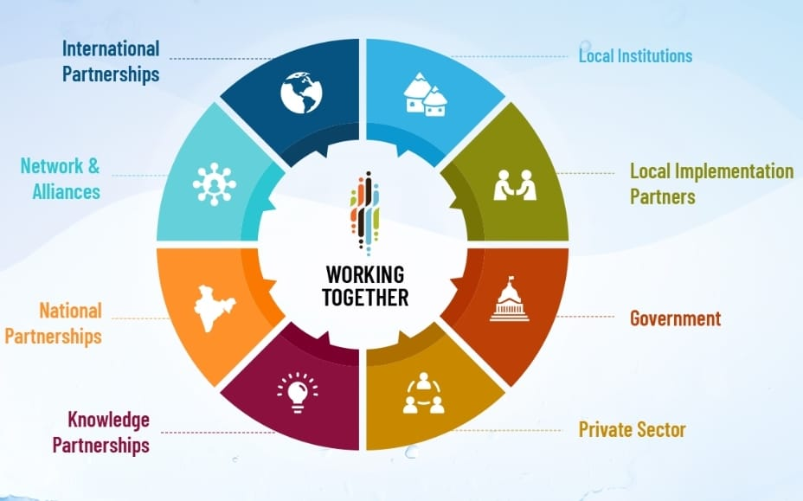
COLLABORATION WITH GOVERNMENT AGENCIES

Slide 22
Social Media Monitoring:
Monitor social media platforms for discussions and trends related to company registrations. This can offer additional insight into market sentiment.

Slide 23
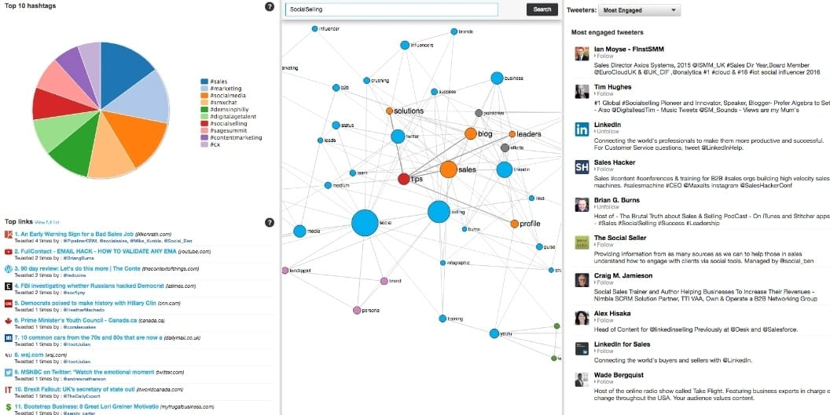
SOCIAL MEDIA MONITORING

Slide 24
Risk Assessment:
Develop a risk assessment component that evaluates the stability and potential of newly registered companies. This can be invaluable for investors and financial institutions.

Slide 25
Machine Learning for Anomaly Detection:
Use machine learning to detect anomalies in registration data. Unusual spikes or drops in registrations can be flagged for further investigation.

Slide 26
Predictive Analytics for Business Ecosystems:
Extend the project to analyze how changes in company registration trends affect the broader business ecosystem, such as employment, supply chains, and industry partnerships.

Slide 27
Cross-Industry Insights:
Provide insights on how trends in one industry might affect or be affected by trends in other industries. This can be beneficial for businesses diversifying their portfolios.

Slide 28
Localized Predictions
Provide localized predictions and insights for specific regions, cities, or even neighborhoods, enabling hyper-local business strategies.

Slide 29
Regulatory Impact Analysis:
Assess the impact of regulatory changes on company registrations and provide stakeholders with the information they need to adapt.

Slide 30
Integration with AI-Powered Investment Platforms:
Partner with investment platforms to provide AI-driven insights for investors looking to make data-informed decisions about startups and emerging businesses.

Slide 31
CONCLUSION
The implementation of AI-driven exploration and prediction of company registration trends with the Registrar of Companies stands as a pioneering innovation that holds immense potential for transforming the way businesses, investors, and government agencies operate in the corporate landscape. By harnessing the power of artificial intelligence, this forward-thinking project empowers stakeholders with invaluable insights, ranging from the analysis of sentiment in news articles to the detection of fraudulent activities and the forecasting of future trends. Through the amalgamation of cutting-edge technologies, this endeavor offers a competitive edge to businesses and enhances regulatory oversight, fostering a more informed, agile, and responsive ecosystem for all participants in the corporate realm. In an era defined by data-driven decision-making, this innovative approach serves as a beacon of progress, illuminating the path to a brighter and more adaptive future.

